Slide 1
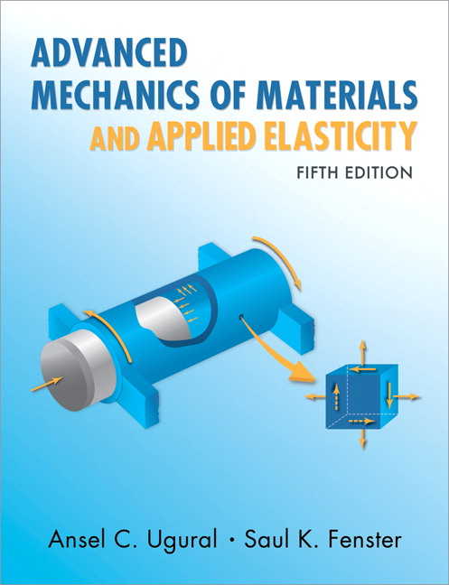
Advanced Mechanics
(Lecture 4)
ANNOUNCE / BUSINESS
HW 1 (due today)
HW 2 (due Th, 1/23)
NEW STUFF
3D rotation – directional cosines
Strain
Compatibility relation
Strain measurement
(index notation)

Slide 2
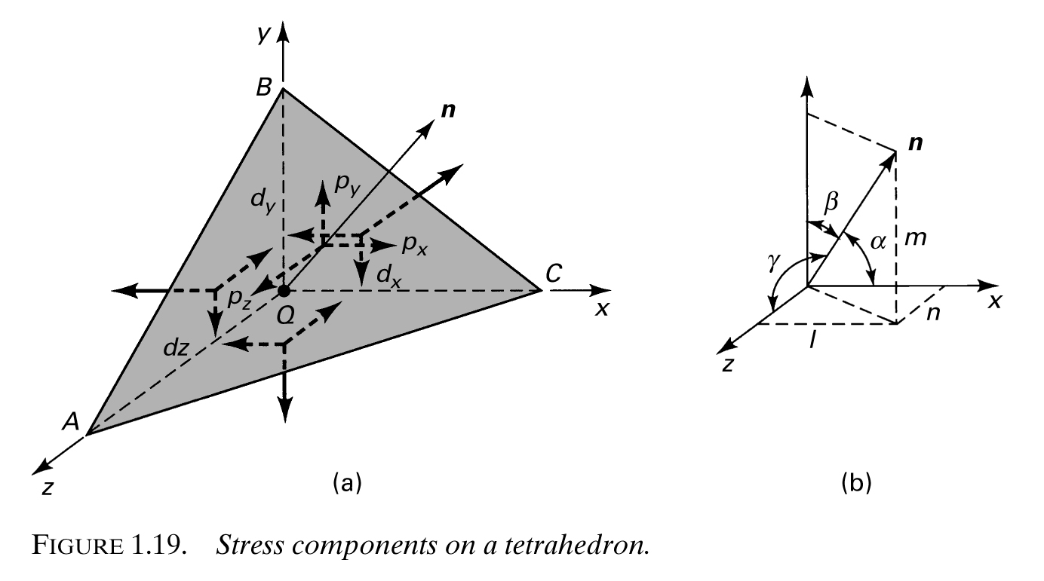
Stress Transformation – 3-D
Enforce equilibrium on tetrahedron with angled surface having normal n

Slide 3



Stress Transformation – 3-D

Slide 4


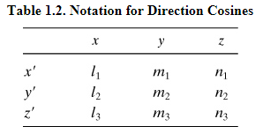
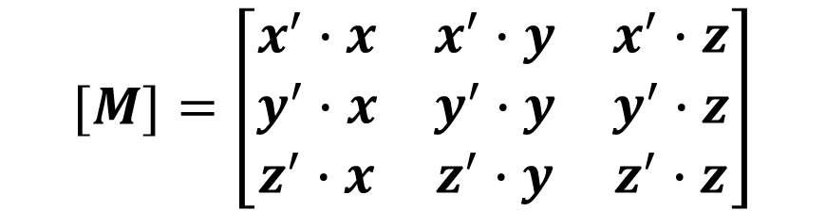




y
Direction Cosines
$$=x′$$
$$1$$
$$1$$
$$1$$
$$[M]=\left[\begin{matrix}x^{′}∙x & x^{′}∙y & x^{′}∙z \\ y^{′}∙x & y^{′}∙y & y^{′}∙z \\ z^{′}∙x & z^{′}∙y & z^{′}∙z\end{matrix}\right]$$

Slide 5
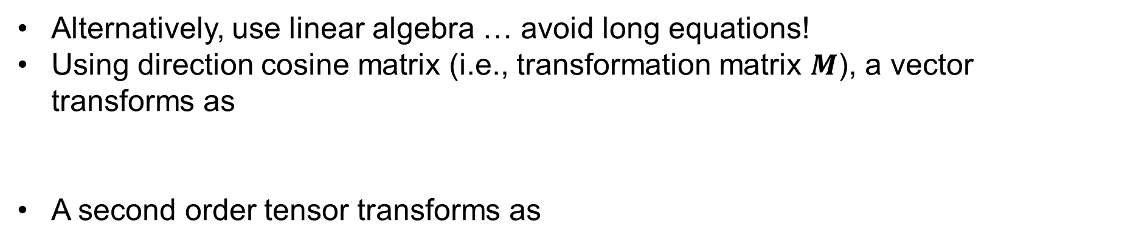
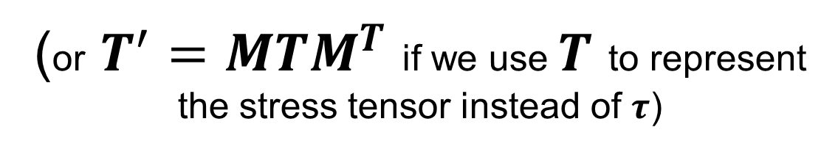


Linear Algebra Approach
Alternatively, use linear algebra … avoid long equations!
Using direction cosine matrix (i.e., transformation matrix $M$), a vector transforms as
A second order tensor transforms as
$$a^{′}=Ma$$
$$τ^{′}=MτM^{T}$$
(or $T^{′}=MTM^{T}$ if we use $T$ to represent the stress tensor instead of $τ$)
* Note that Eqn’s 1.29 in the text have incorrectly switched the transform order

Slide 6
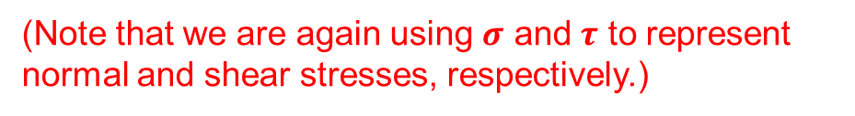

Principal Stress – Stress on Arbitrary Plane
The traction, or stress, vector t gives the magnitude and direction of force per unit area acting on any surface.
(Note that we are again using $σ$ and $τ$ to represent normal and shear stresses, respectively.)
t, traction vector
σ, normal stress
cutting plane
$$t=Tn=σ+τ$$
τ,
shear stress
n, surface unit
normal vector

Slide 7



Principal Stresses
Determine the particular surface normal n that maximizes the normal stress $$ and zeros the shear stress $τ$. In this case,
That is, we seek a coordinate system in which the stress tensor is diagonalized
Note that this is just one surface of 3
$$t=σ$$
cutting plane
$$t=Tn=σ+τ=σn$$
n, surface unit
normal vector

Slide 8

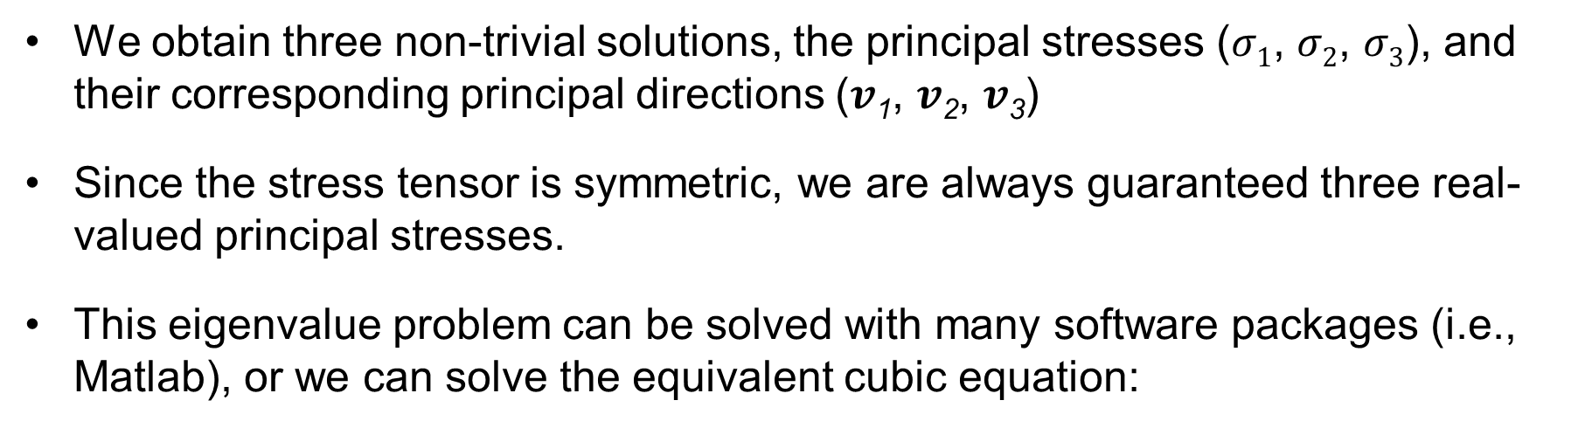
Eigenvalue Problem
$\left(T−σ1\right)v=0$ (replacing $n$ with $v$)
We obtain three non-trivial solutions, the principal stresses ($σ1$, $σ2$, $σ3$), and their corresponding principal directions ($v$₁, $v$₂, $v$₃)
Since the stress tensor is symmetric, we are always guaranteed three real-valued principal stresses.
This eigenvalue problem can be solved with many software packages (i.e., Matlab), or we can solve the equivalent cubic equation:
$$\det\left(T−σ1\right)=0$$
* It is fine to use Matlab or any other computational tool to solve this and other linear algebra problems required for homework.

Slide 9

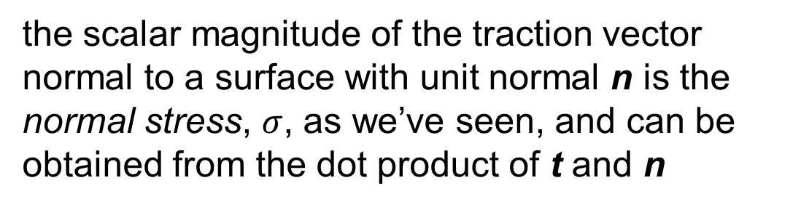

Stresses on an Arbitrary Plane
Recalling our relationships for the traction vector,
t, traction vector
$$t=Tn=σ+τ$$
σ, normal stress
the scalar magnitude of the traction vector normal to a surface with unit normal n is the normal stress, $σ$, as we’ve seen, and can be obtained from the dot product of t and n
cutting plane
τ,
shear stress
n, surface unit
normal vector
$$σ=t∙n$$
Notes:
Recall notes on stresses on inclined plane in Lecture 3

Slide 10
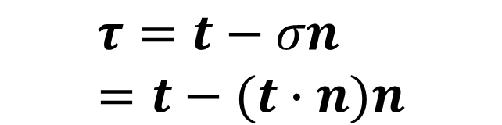
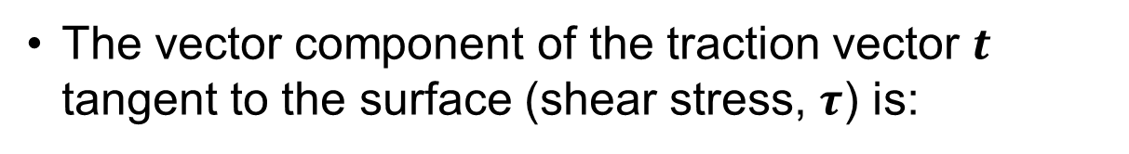
Stresses on an Arbitrary Plane
The vector component of the traction vector $t$ tangent to the surface (shear stress, $τ$) is:
t, traction vector
σ, normal stress
cutting plane
$$τ=t−σn=t−(t∙n)n$$
τ,
shear stress
n, surface unit
normal vector
*As with stress transformation, the book provides equations to calculate values for normal and shear stress on an arbitrary surface, but the linear algebra approach is much simpler to remember.

Slide 11
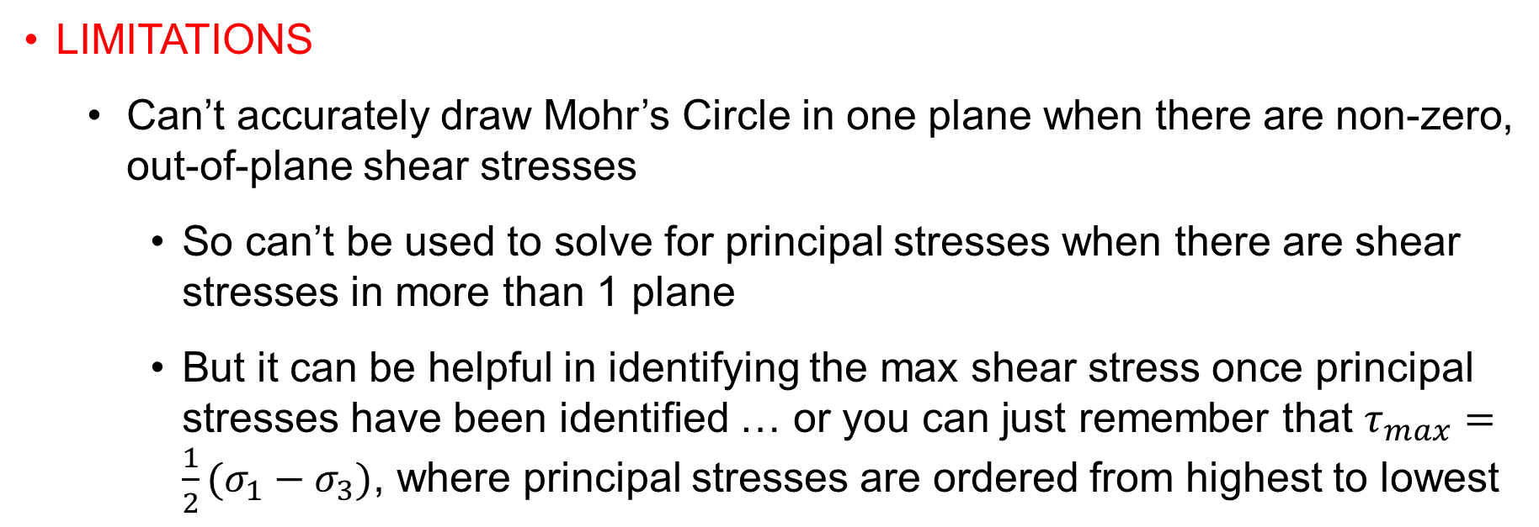
Mohr’s Circle – 3D
Limitations
Can’t accurately draw Mohr’s Circle in one plane when there are non-zero, out-of-plane shear stresses
So can’t be used to solve for principal stresses when there are shear stresses in more than 1 plane
But it can be helpful in identifying the max shear stress once principal stresses have been identified … or you can just remember that $τ_{max}=\frac{1}{2}(σ_{1}−σ_{3})$, where principal stresses are ordered from highest to lowest

Slide 12
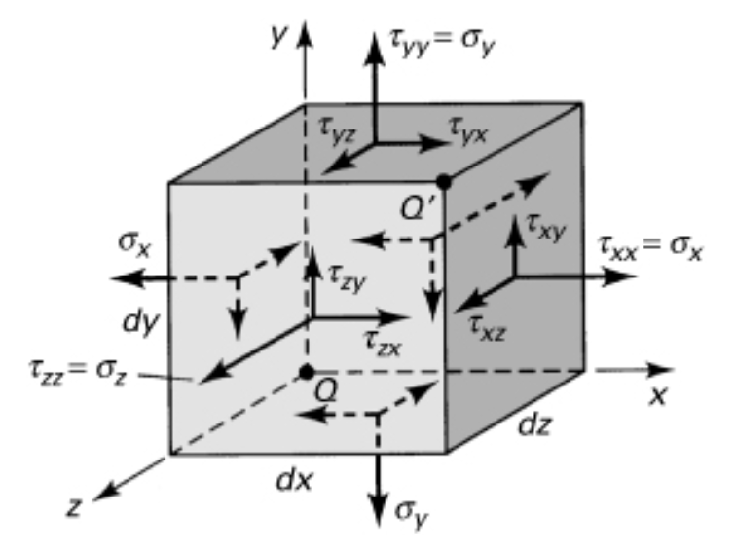
Recap of 3-D stress topics
Stress transformation
Principal stresses
Stresses on arbitrary surface

Slide 13
Quiz
Given the stress state shown, determine
(1) the maximum principal stress
(2) max shear stress
20 MPa
20 MPa

Slide 14
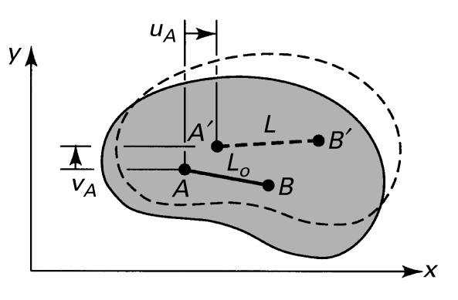
Deformation
Body is deformed, or strained, if relative distance between points changes
Deformation v. rigid body displacement
Displacement field defines motion of every point
$$u=u(x,y,z)$$
$$v=v(x,y,z)$$
$$w=w(x,y,z)$$

Slide 15
Superposition
Superposition allows us to combine the effects of multiple loads to determine total stress or strain (common strategy in mech of mat’ls)
Limited to linear elastic materials AND small (infinitesimal) displacements

Slide 16
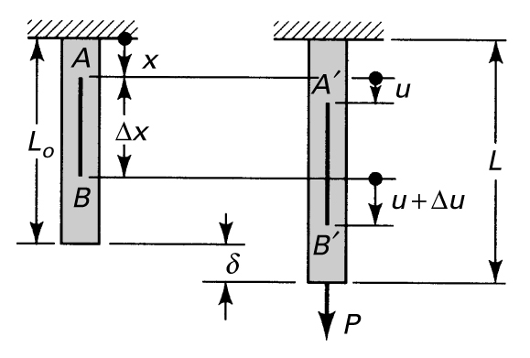


Strain
If deformation is uniform,
We call this a homogeneous, or affine, deformation since it is the same throughout the body
Note: There are many different ways to define strain other than what we’ll use in this class

Slide 17
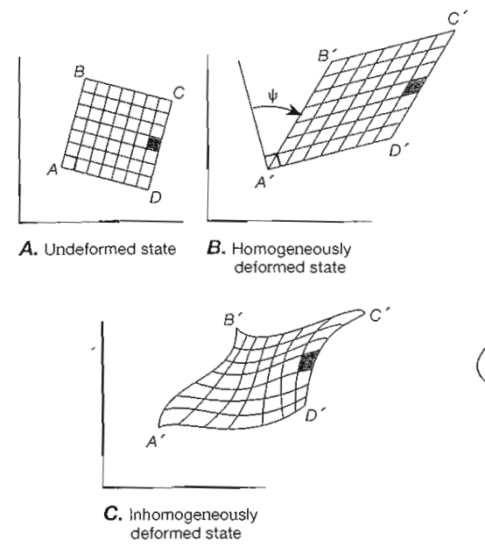
Deformation Homogeneity

Slide 18
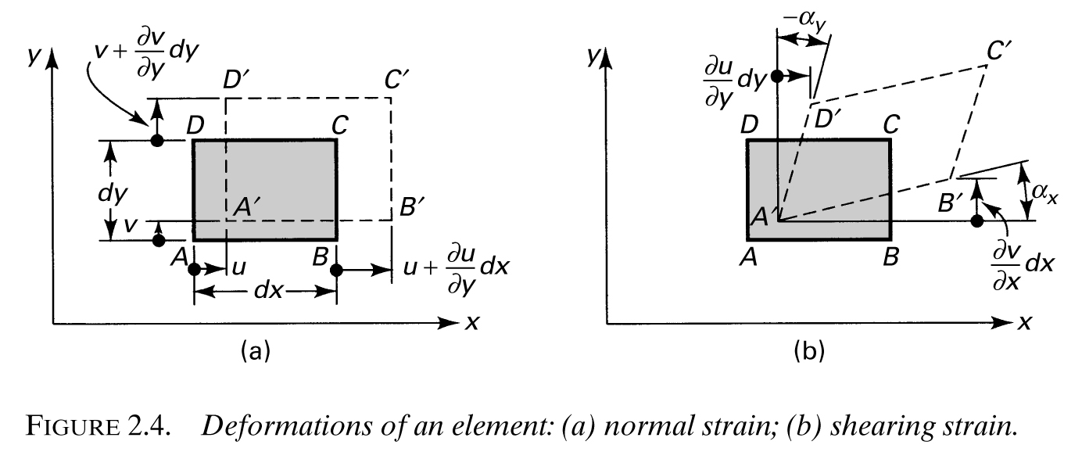




Plane Strain – Infinitesimal (small)
*
$$\frac{∂u}{∂x}$$
$$\frac{dv}{dx}=tan⁡(α_{x})≈α_{x}$$
* error in book
Can calculate strain directly from disp
$$u=u(x,y,z)$$
$$v=v(x,y,z)$$
$$w=w(x,y,z)$$

Slide 19




Plane Strain – Large Deformations
$$\frac{∂u}{∂x}$$
Different formulation based on difference between squared lengths of segments: “Green-Lagrange Strain”
Notes:
- Large strains often calculated using relationships between squares of element lengths

Slide 20
Plane Strain – Infinitesimal
$$\frac{∂u}{∂x}$$
Note, then, that infinitesimal strain expressions are limited (small strains)

Slide 21
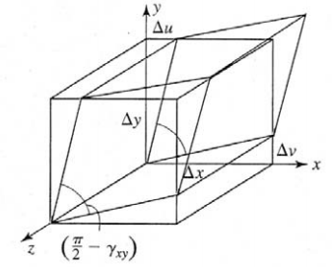
Strain – 3D
Infinitesimal strains can be generalized to 3-D
Note that there is no difference between shear strains in the same plane.
These strain-displacement relations are sometimes called kinematic relations.

Slide 22



Strain – 3D
Like stress, strain is a symmetric second-order tensor
… but only when we use tensorial, instead of engineering, shear strains
Tensorial strains can be expressed using compact form with index notation:

Slide 23
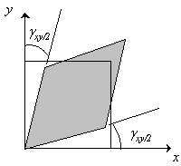
Shear Strain
Produces distortion only … no change in length of element
Positive when angle between positive faces is reduced
Note that rigid rotation does not produce shear

Slide 24
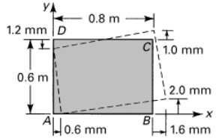
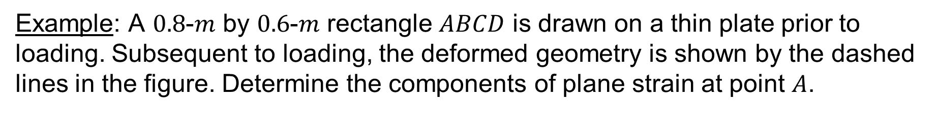
Strain – Example
Example: A $0.8$-$m$ by $0.6$-$m$ rectangle $ABCD$ is drawn on a thin plate prior to loading. Subsequent to loading, the deformed geometry is shown by the dashed lines in the figure. Determine the components of plane strain at point $A$.
* displacements magnified for clarity

Slide 25



Strain – Example
Assuming small deformations, we use the infinitesimal strain-displacement relations …
$${10}^{−6}$$
(“micros” or “microstrain”)

Slide 26

Strain – Example
Assuming small deformations, we use the infinitesimal strain-displacement relations …
$${10}^{−6}$$
(“micros” or “microstrain”)

Slide 27


Strain – Example
Assuming small deformations, we use the infinitesimal strain-displacement relations …
$${10}^{−6}$$
(“micros” or “microstrain”)
Note that we would get different results for different points – this deformation is not homogeneous.

Slide 28


Strain – Equations of Compatibility
We derived 6 strains from just 3 displacements, so strains can’t be independent
How are they related? Compatibility equations …
Compatibility ensures that deformations are continuous, that, for example, no voids open up in the material as a consequence of loading
Commonly used in linear elasticity to properly constrain solutions to require physically reasonable deformations

Slide 29
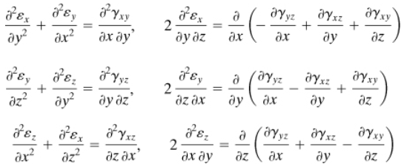
Strain – Equations of Compatibility

Slide 30
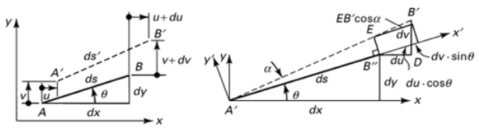

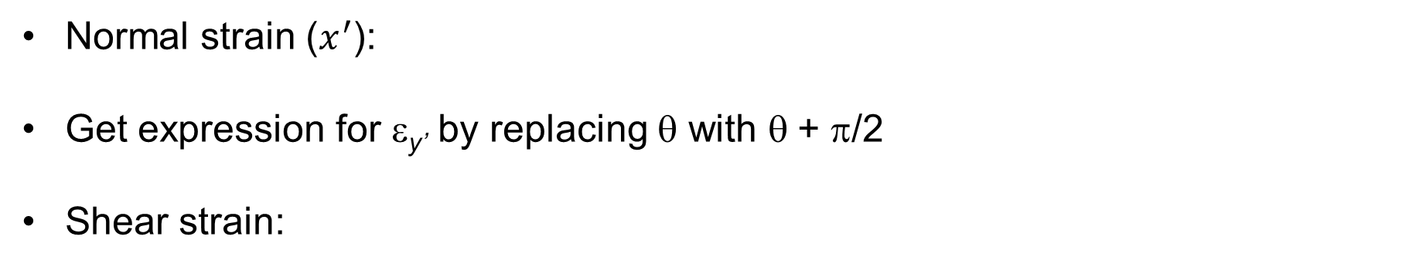
Strain Transformation – 2-D
Normal strain ($x^{′}$):
Get expression for ε_{y’} by replacing θ with θ + π/2
Shear strain:
Note that these are the same as the stress transformation equations, except that σ is replaced by ε and τ is replaced by γ/2

Slide 31
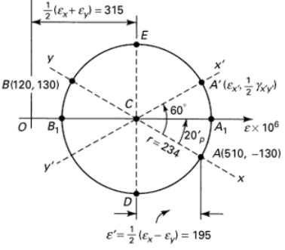

Mohr’s Circle for Strain (optional content)
Not surprisingly, Mohr’s circle works the same for strain as for stress … with tensorial shear strains
Example: The state of strain at a point on a thin plate is given by ε_{x} = 510 μ, ε_{y} = 120 μ, and γ_{xy} = 260 μ. Draw Mohr’s Circle.
(ignore the primed coord system … we’re just drawing the circle here)

Slide 32
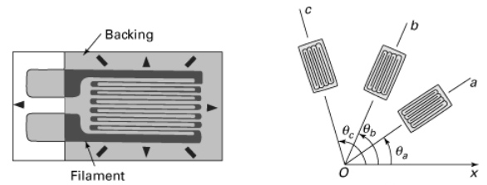

Strain Gauge Rosette
y
Measured gauge strains and known angles … 3 eq’ns, 3 unknowns
This is the only way to determine shear strain – strain gauges only measure normal strain, in one direction
Notes:
How a strain gage works: known relationship between electrical resistance and strain
Rosette allows measurement of multiple components of strain simultaneously

Slide 33
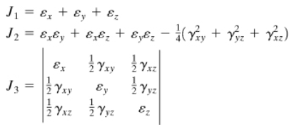

Strain Transformation – 3-D
The same substitution into the 3-D stress transformation equations produces the 3-D strain transformation equations.
Strain transforms the same as stress because all second-order tensors transform the same way (as long as use tensorial strains)
Invariants are defined similarly
$$ε^{′}=MεM^{T}$$

